Slide 1
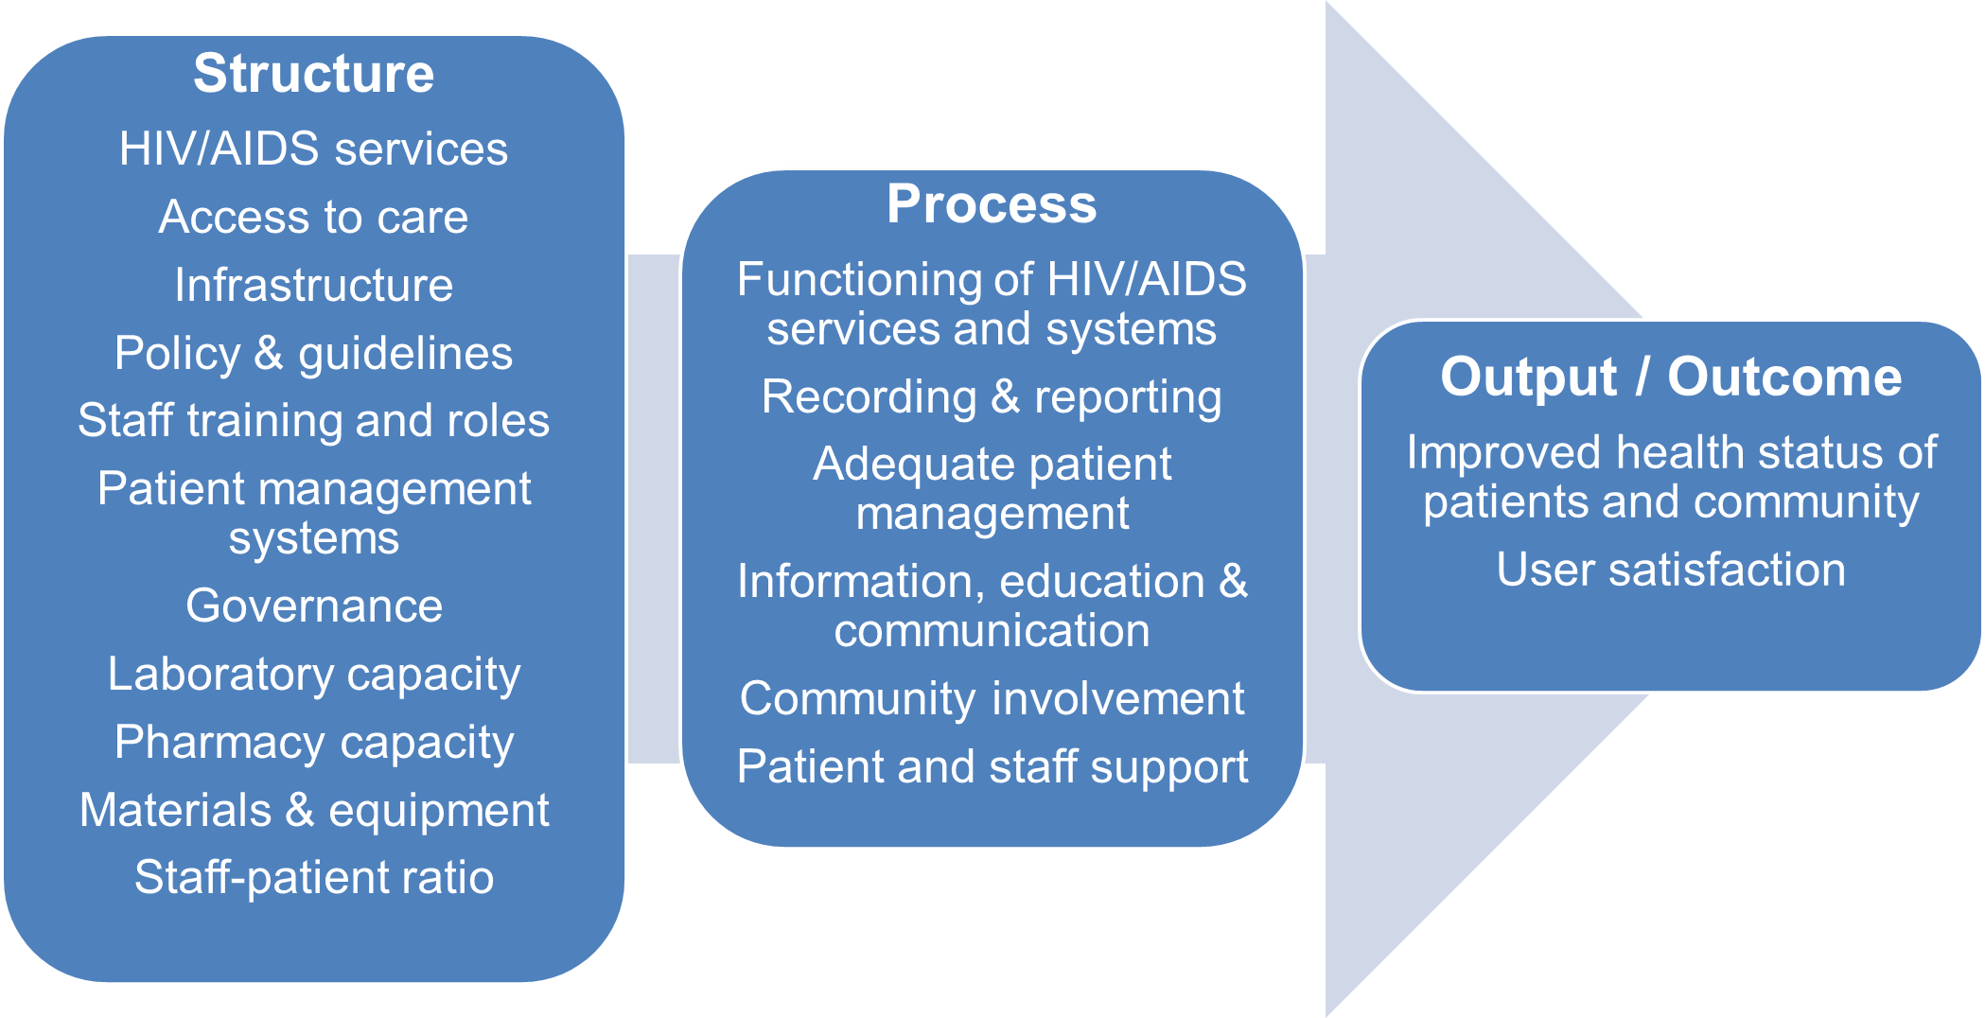
Figure 1 Framework for indicator clusters

Slide 2
Table1: Demographical data of clinics (n = 20)
 | n | %
Local government (municipality) | 8 | 40
Provincial government | 12 | 60
Clinics with NGO support for HIV programme | 8 | 40
Clinics with no NGO support for HIV programme | 12 | 60
Clinics where ART was available | 10 | 50
Clinics where ART was not available | 10 | 50

